Slide 1
USAFA Strategic Communications
Mike Peterson
USAFA/CM
Chief, Outreach Division
1

Slide 2
The Year In Review . . .
“When I’m on the road, build me engagement events”
Supt’s first year at the helm: 34 events – coast-to-coast
Parents/Grads; Donors; Industry; Higher Ed; Sports!
Founders Day Dinners x 5
You make requests . . . I make requests!
Supt has challenged his senior staff, too
Commandant; Dean; AD; Vice Supt; CCLD
Founders Day – we have more volunteers than requests!
Appointee Events
All-Service Academy Ball
2

Slide 3
Looking to the Future . . .
Parent Communications Working Group
Going strong after 1-yr; Meeting quarterly
AOC; DF; Coaches; Admissions; Prep School; AOG; UE
Upcoming focus on deliberate comm’s/milestone events
On the horizon . . .
Planetarium/STEM Center – The Digital Dome
New Visitor Center
USAFA Web-Based Virtual Reality Tour
Volunteer Docent Tour Program
Chapel renovation – a “once-in-a-lifetime” opportunity!
501c3 Partnership – even stronger in 2019!
3

Slide 4
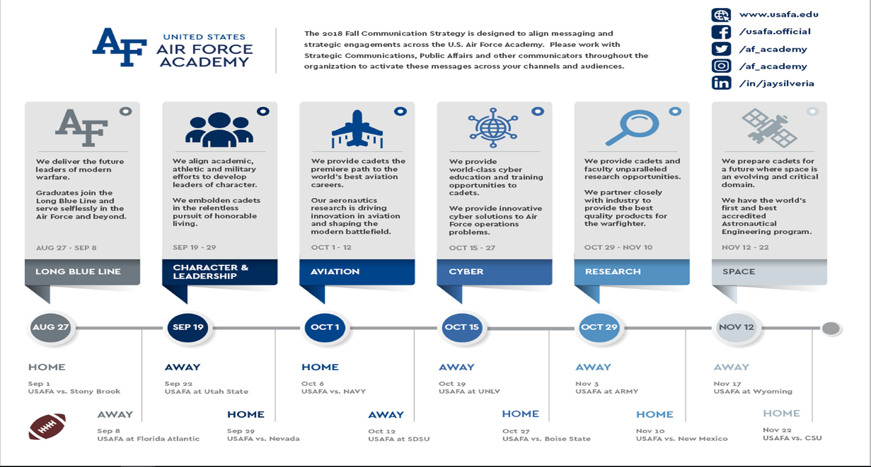
2018 Fall Strategy & Themes
4

Slide 5
5

